Slide 1
Housing Investment
Abhilash Ashok

Slide 2
Introduction
Problem faced during buying a house :
1)Buying a house is a stressful thing
2) Buyers are generally not aware of the the pricing due to various factors
3)Many problems are faced during buying a house.
4) A lot of misunderstanding between the buyers and sellers as well as the brokers which could mislead on the main cause that is being persisted.

Slide 3
They believe it depends upon :
1)The square foot of the area
2)Neighbourhood
3) Number of Bedrooms
But it depends on number of factors like :
Number of storeys
Area outside the house
Rooms in each floor

Slide 4
Project Summary
My project is a machine level model,based on certain specification of your future home,would try to guess the most accurate price based on the different features that are persisted .

Slide 5
Steps Leading the Project
I have two data sets, i.e. Train Data and Test Data samples.
I would first work on the Train dataset,and check how the dataset would work when trained.
Using the dame model I would merge to the test dataset and check for the efficiency.

Slide 6
Train Data
I observed that it is having 1168 Rows and 81 columns.
I checked for the missing values and found some of the columns had a missing value which I need to treat all those.
I treated those missing values with most of the mode method and filled all the missing values.
I next try to check those missing values with that of the Label dataset how is it affecting the each

Slide 7
Train Data
I next categories the different types of features present in the Train data.
First to the Numerical category
Secondly with the Discrete category
I also add on for the continuous data category features that are present

Slide 8
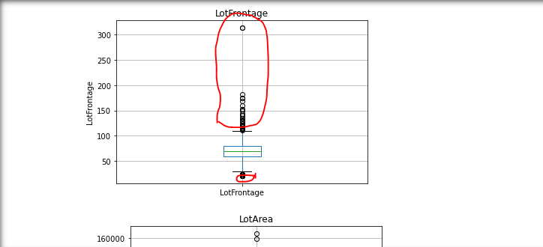
Train Data
I check for the outliers if any present amongst the features which coukd help me to manipulate the data more further.
Eg. : In the below figure the marked in “Red” is the outlier

Slide 9
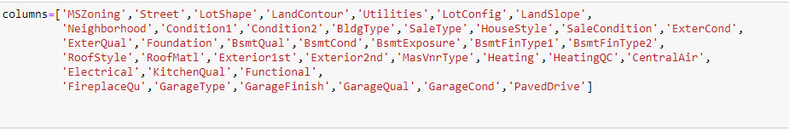
Train Data
I have categorized the all the necessary columns required into one variable which is legit.

Slide 10
Test Data
I would now bring in the test data and try to merge with the manipulated data.
I would treat all the features of the test data as prepared for that of the trained data.
I see the test data is having 292 rows and 80 columns
After the merged data I use One hot encoder to convert all

Slide 11
Model Building
I have used
1) XGB Regressor/Classifier
2)Random Forrest Regressor
3)Gradient Boosting Classifier

Slide 12
Thank You

Slide 13
